Slide 1
Logic Shift and Rotation
Reference: Assembly Language Programming and Organization of the IBM PC – Charles Marut – Chapter 7

Slide 2
Shift

Slide 3
Content
Introduction
Types of Shift Logical shift Shift Left Shift right
Arithmetical shift Shift arithmetic left
Shift arithmetic right
Reference

Slide 4
Introduction
Shift operation move the bits in a pattern, changing the position of the bits. They can move bits to the left or to the right. We can divide shift operation into two categories:
1. Logical Shift
2. Arithmetic Shift

Slide 5
Logical Shift
A logical shift moves the bits within the cell one position to the right or to the left
In a logical right shift, the least significant bit LSB is discarded and the most significant bit MSB is assigned 0.
In a logical left shift, the LSB is assigned 0 and the msb is discarded.
A shift instruction will have an operand that specifies how many times the one position shift is applied.
There are two kinds of Logical shift:
1. Shift Left
2. Shift Right

Slide 6
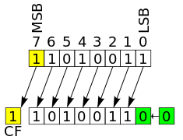
Left Shift
A shift left logical of one position moves each bit to the left by one. The low-order bit LSB is replaced by a zero bit and the high-order bit MSB move to CF (Carry Flag)
Shifting by two positions is the same as performing a one-position shift two times. Shifting by zero positions leaves the pattern unchanged. Shifting an N-bit pattern left by N or more positions changes all of the bits to zero.
The picture shows the operation performed on eight bits. The original pattern is 11010011. The resulting pattern is 10100110.

Slide 7
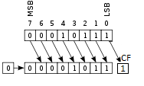
Right shift
A shift right logical of one position moves each bit to the right by one. The high-order bit MSB is replaced by a zero bit and the low-order bit LSB move to CF (Carry Flag)
Shifting by two positions is the same as performing a one-position shift two times. Shifting by zero positions leaves the pattern unchanged. Shifting an N-bit pattern right by N or more positions changes all of the bits to zero.
The picture shows the operation performed on eight bits. The original pattern is 00010111. The resulting pattern is 00001011.

Slide 8
Arithmetic shift
Arithmetic shift operations assume that the bit pattern is a signed integer in two’s complement format. Arithmetic right shift is used to divide an integer by two, while arithmetic left shift is used to multiply an integer by two.
There are two kinds of arithmetic shift:
1. Left arithmetic shift
2. Right arithmetic shift

Slide 9
Left Arithmetic shift
An shift arithmetic left is the same as a logical left shift
A shift arithmetic left of one position moves each bit to the left by one. The low-order bit LSB is replaced by a zero bit and the high-order bit MSB move to CF (Carry Flag)
A left arithmetic shift by n is equivalent to multiplying by 2^{n} . In 2’s complement, positive or negative, a logical left shift, is equivalent to multiplication by two.
The picture shows the operation performed on eight bits. The original pattern is 11010011. The resulting pattern is 10100110.

Slide 10
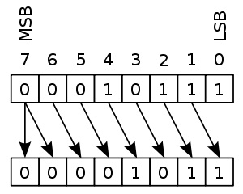
Shift Arithmetic Right
A shift arithmetic right of one position moves each bit to the right by one. The high-order bit MSB is replaced by sign bit and the low-order bit LSB move to CF (Carry Flag)
A shift arithmetic right is equivalent to integer division by two.
In 2’s complement, positive or negative, division by two is accomplished via an shift arithmetic right .
The picture shows the operation performed on eight bits. The original pattern is 00010111. The resulting pattern is 00001011

Slide 11

Rotation

Slide 12

Contents
Types of Rotation
ROL Instruction
ROR Instruction
Difference
RCL Instruction
RCR Instruction

Slide 13
Types
Rotation
ROL
ROR
RCL
RCR

Slide 14
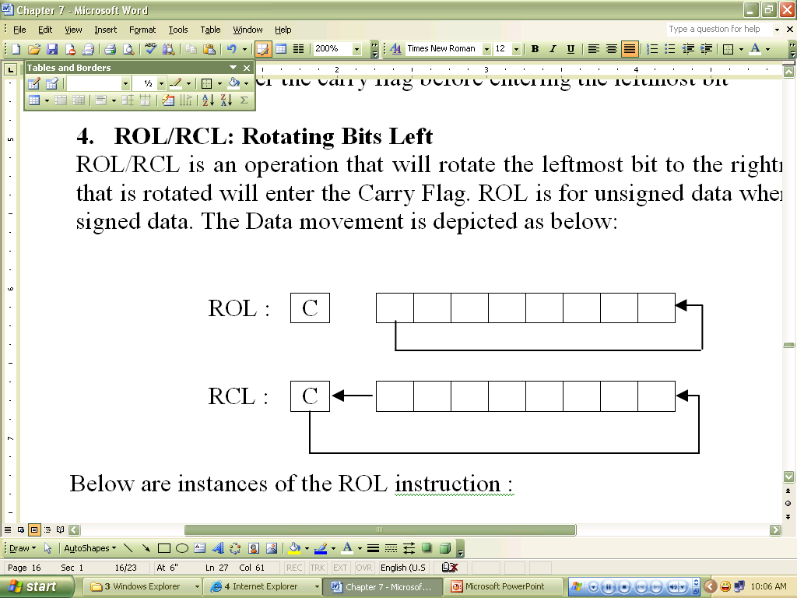
ROL Instruction
ROL (rotate) shifts each bit to the left
The highest bit is copied into both the Carry flag and into the lowest bit
No bits are lost
ROL is used for unsigned data

Slide 15
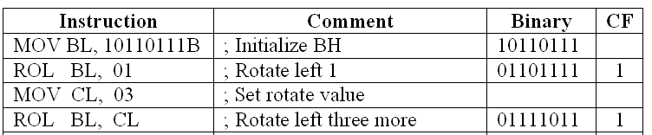
Below are instances of the ROL instruction :
1
2
3
CF
1
 |  | 1 | 0 | 1 | 1 | 0 | 1 | 1 | 1
BH
1
2
1 |  | 0 | 1 | 1 | 0 | 1 | 1 | 1 | 1
1
011
3
1 |  | 0 | 1 | 1 | 1 | 1 | 0 | 1 | 1
011

Slide 16
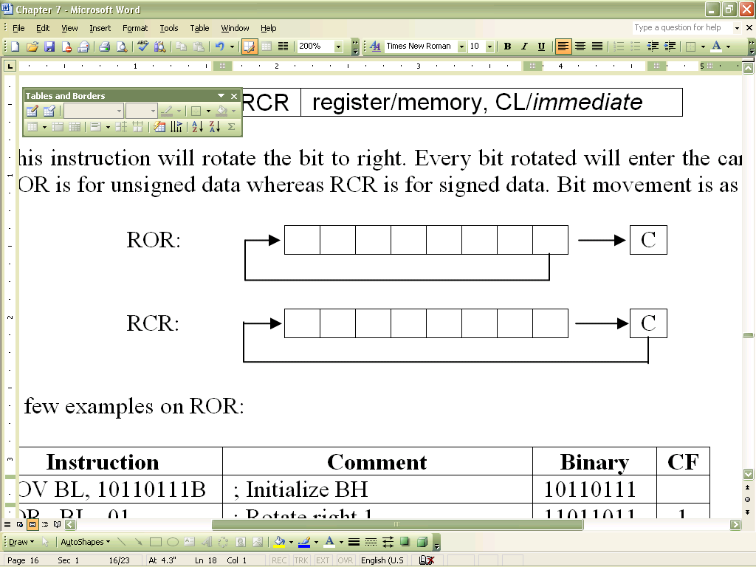
ROR Instruction
ROR (rotate right) shifts each bit to the right
The lowest bit is copied into both the Carry flag and into the highest bit
No bits are lost
ROR is for unsigned data

Slide 17
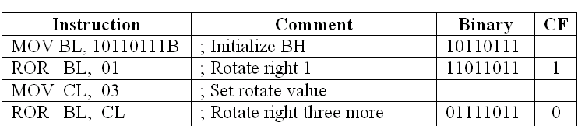
A few examples on ROR:
1
2
3
CF
1
BH
1 | 0 | 1 | 1 | 0 | 1 | 1 | 1
1
2
1 | 1 | 0 | 1 | 1 | 0 | 1 | 1 |  | 1
011
3
0 | 1 | 1 | 1 | 1 | 0 | 1 | 1 |  | 0
011

Slide 18
RCL Instruction
RCL (rotate carry left) shifts each bit to the left
Copies the Carry flag to the least significant bit
Copies the most significant bit to the Carry flag
RCL is for signed data

Slide 19
Example:
CLC ; CF = 0
MOV BL,88H ; CF,BL = 0 10001000B
RCL BL,1 ; CF,BL = 1 00010000B
RCL BL,1 ; CF,BL = 0 00100001b
CF
0 |  | 1 | 0 | 0 | 0 | 1 | 0 | 0 | 0
BL
1 |  | 0 | 0 | 0 | 1 | 0 | 0 | 0 | 0
0
1
0 |  | 0 | 0 | 1 | 0 | 0 | 0 | 0 | 1

Slide 20
RCR Instruction
RCR (rotate carry right) shifts each bit to the right
Copies the Carry flag to the most significant bit
Copies the least significant bit to the Carry flag

Slide 21
Example:
STC ; CF = 1
MOV AH,10H ; CF,AH = 00010000 1
RCR AH,1 ; CF,AH = 10001000 0
CF
AH
0 | 0 | 0 | 1 | 0 | 0 | 0 | 0 |  | 1
1
1 | 0 | 0 | 0 | 1 | 0 | 0 | 0 |  | 0

Slide 22
Difference
The difference between ROR and RCR is only the way of operation. In RCR, every bit that is rotated will enter the carry flag before entering the leftmost bit
RCL works like just like ROL except that CF is part of the circle of bits being rotated.

Slide 23
The End

